Slide 1
Spring Officer Elections 2024
Campaigning Guidance Session

Slide 2
Contents
Theme
Slogans and standing out
Creating materials for campaigns
Areas to focus on, but not exclusively
Slates and endorsements
Voting booths
Example lecture shoutout
Campaigns teams

Slide 3
Theme
Easier to campaign if you have your own unique brand
Colour schemes, themes, acronyms etc.
Expenses and materials
Communication
Content
Social media
Talk about yourself and your points, not other candidates

Slide 4
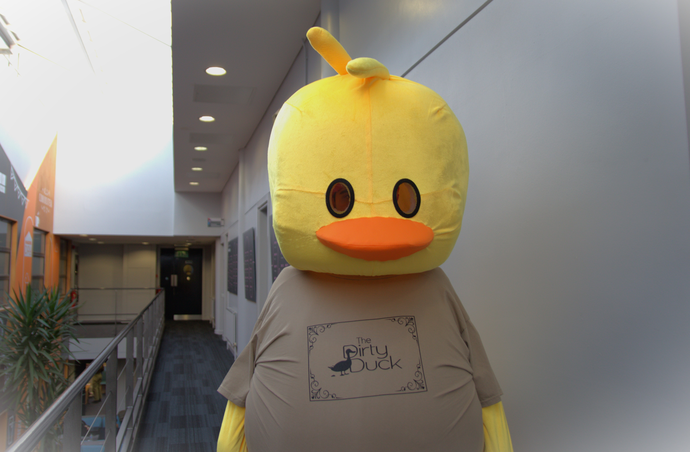
Slogans and Standing Out
Catchy slogan?
Most important parts are who you are, what you stand for, voting
Memorable
Make sure you are differentiated from other candidates
Stand out to whatever degree you want

Slide 5
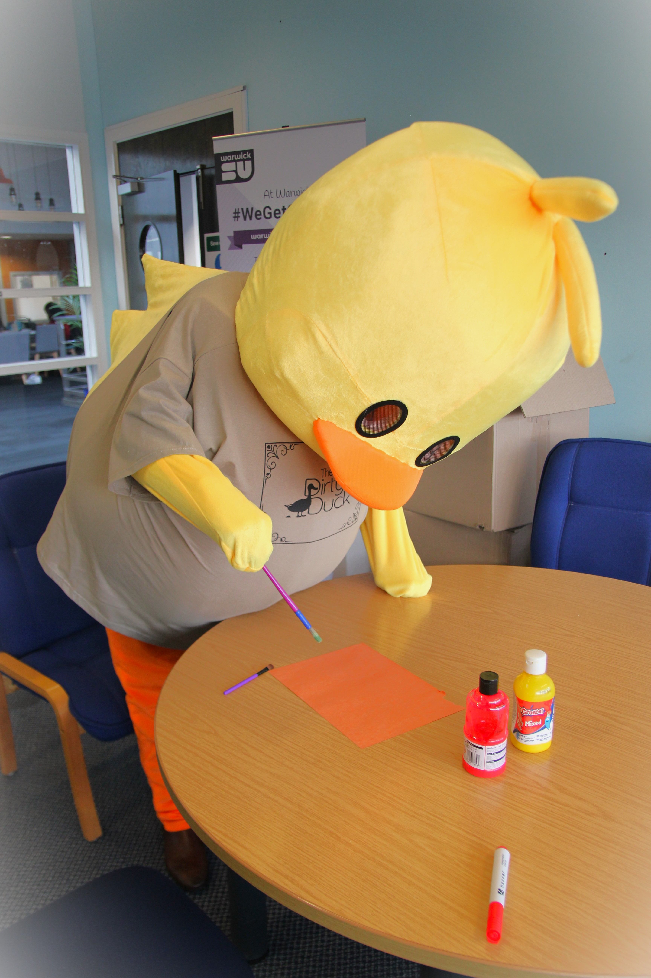
Creating materials for campaigns
Collectively creating banners and placards with your campaign's team
Try to maintain a certain colour scheme throughout your campaigns
Campaigning isn't limited to leafleting, flyering and creating posters, there are other ways to campaign – infographics, attending interviews with the RAW, getting your name out there through casual chats with other students
Try to make sure all the avenues you use for campaigning – whether its through placards, leafleting, interviews etc fit in to a general strategy

Slide 6
Expenses and Materials
FTO Candidates can reimburse a total of £50 per candidate
PTO Candidates can reimburse a total of £35 per candidate
Any found to have spent over this will be disqualified
Deadline for reimbursements is 31/03/2023

Slide 7
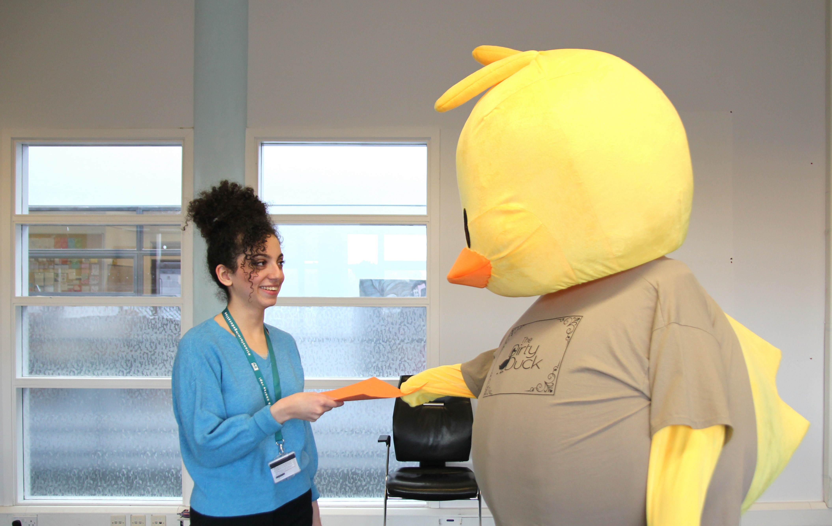
Communication
Lecture / Seminar shoutouts
Face to face campaigning on campus
Hall touring
Question Time
Voting Booths

Slide 8
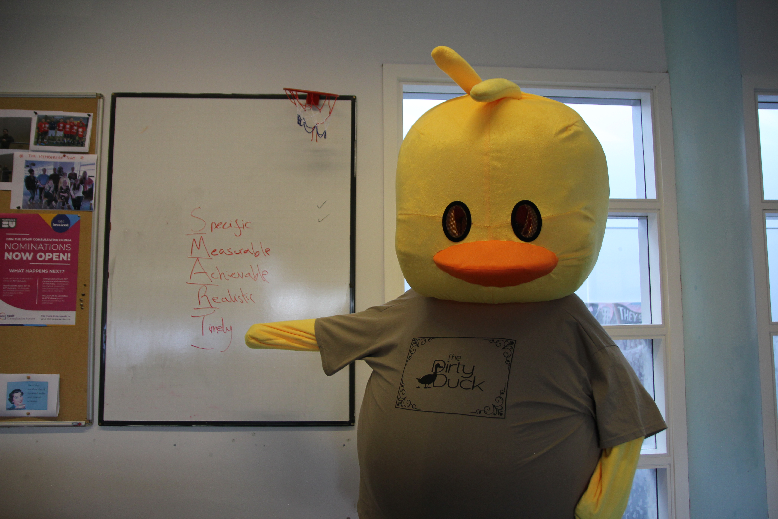
Conduct
Be respectful of spaces on and off campus
Don't focus on other candidates, you're campaigning for yourself!
No personal attacks
No negative campaigning (defined in the candidate guide)
You are responsible for the actions of your campaign team

Slide 9
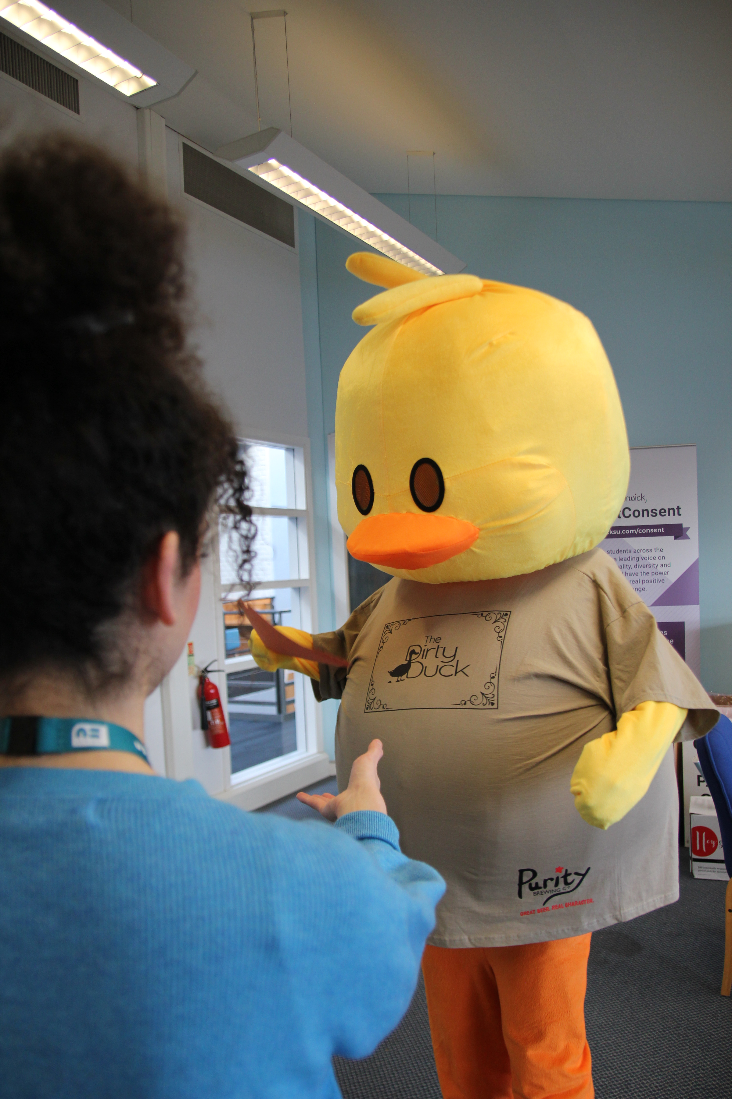
Social Media
External Campaigners not allowed (solicited)
Facebook?
Twitter?
Instagram?
TikTok?
WeChat?
Custom pages / Linktree?

Slide 10
Social Media
Follow SU code of conduct with posts
Same rules for candidate behaviour as in person
Group chats allowed
Do not repeatedly post on SU posts
You may make a page / profile now but it must be private until the start of campaigning
You cannot reuse pages or profiles from previous years, regardless of whether you were elected or not

Slide 11
Slates and Endorsements
Slates are defined as more than one candidate running for different positions under the same banner / ideas / manifesto etc.
This means candidates are not allowed to pool their resources, appear in each other’s publicity, have identical or almost identical publicity / manifesto content, or endorse other candidates.
Societies and Sports cannot endorse candidates
SU Staff members cannot endorse candidates
Joint Candidacies are also prohibited

Slide 12
Voting Booths
Direct students towards Voting Booths
Do not campaign near voting booths
Leave manifestos on a posterboard by voting booths
Booths will have tablets for students to sign up and vote on
STV voting diagram

Slide 13
Example Lecture Shoutout
Ask permission first
Keep it quick
Remember your name, position and voting!
A few of your manifesto points as quick as possible
Tailor it to your audience and think of who you’re speaking to

Slide 14
Campaigns Teams
Your team
Teams must be registered here: Spring Officer Elections - Campaign Team Registration
Team managers / members are responsible for your campaign
Subject to rules and regs
Students only

Slide 15
Any questions?
Click to add contact email

